Slide 1
Create First Tkinter GUI Application

Slide 2
Whats a Tkinter?
provides a variety of widgets like buttons, labels, text boxes, menus and more that can be used to create interactive user interfaces.
Tkinter supports event-driven programming, where actions are taken in response to user events like clicks or keypresses.

Slide 3
Create First Tkinter GUI Application
Import the tkinter module
Create the main window (container)
Set Window Properties
Add widgets to the main window (buttons, label, fields)
Pack Widgets (grid(), place())
Apply event triggers to the widgets (define how the application should respond)

Slide 4
mainloop()
The mainloop() method is used to run application once it is ready. It is an infinite loop that keeps the application running, waits for events to occur (such as button clicks) and processes these events as long as the window is not closed.

Slide 5
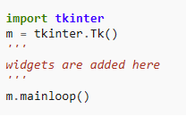
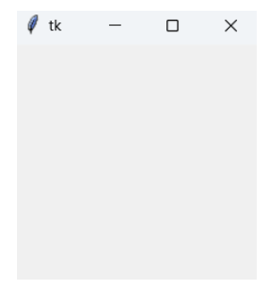

Slide 6
Tkinter Widget
There are a number of tkinter widgets which we can put in our tkinter application. Some of the major widgets are explained below: Label, Button, Entry

Slide 7
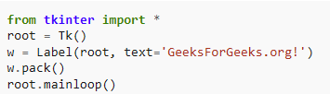
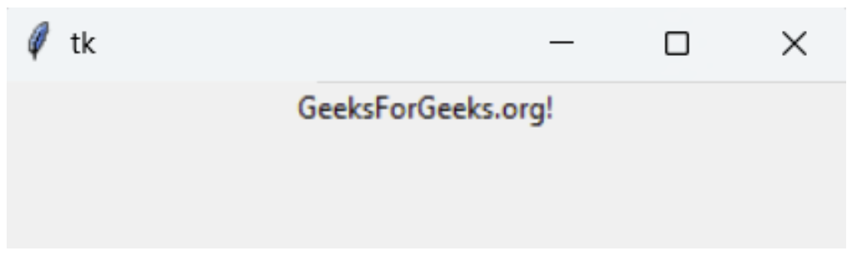
Label
It refers to the display box where we display text or image. It can have various options like font, background, foreground, etc. The general syntax is:
w=Label(master, option=value)
master is the parameter used to represent the parent window.

Slide 8
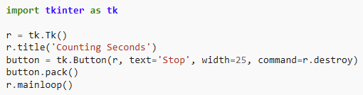

Button
A clickable button that can trigger an action. The general syntax is:
w=Button(master, option=value)

Slide 9
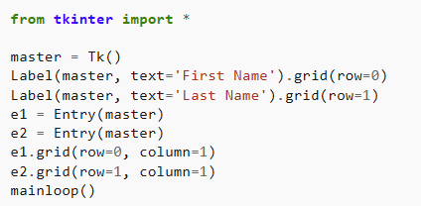
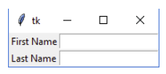
Entry
It is used to input the single line text entry from the user. For multi-line text input, Text widget is used. The general syntax is:
w=Entry(master, option=value)

Slide 10
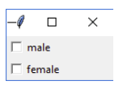
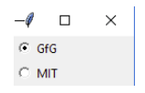
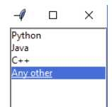
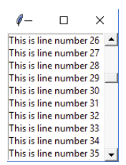
Cоздайте графический интерфейс со следующими данными:
CheckButton
Radio Button
Listbox
Scrollbar

